Slide 1
IDATG2206 Introduction to Spatial Filtering
Correlation, Convolution, Template Matching

Slide 2
Spatial filtering
Many-to-one instead of one-to-one mappings (point transformations).
A pixel is transformed through a linear combination of its neighbours.
Key operations: convolution and correlation
Examples from 1D to 2D

Slide 3
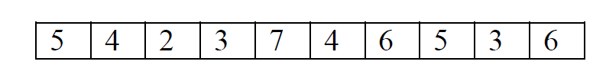
Correlation
Let’s take a 1D case.
Let’s suppose we want to replace each pixel with the average of its neighbours.
What about the first and last elements (boundaries)?
Padding with zeros
Replicate the first and last elements
Assume cyclic repetition of elements

Slide 4
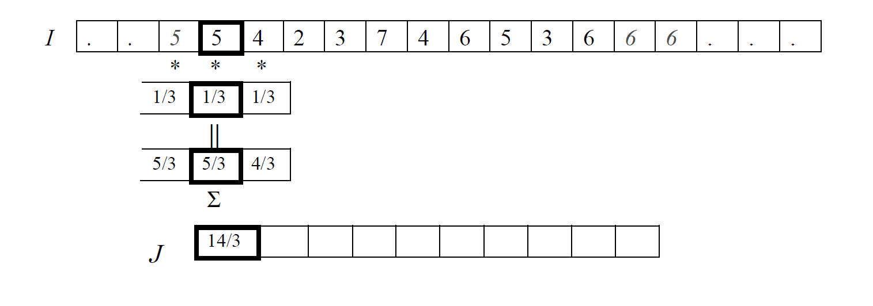
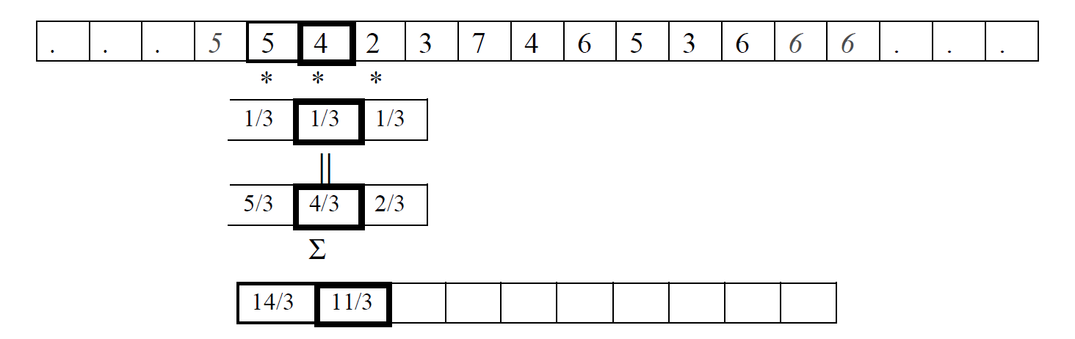
Correlation as a Windowed Operation
Filter/window/kernel
Dot Product
We apply the same operation to all pixels → shift-invariant
Sliding/moving the filter to the next pixel

Slide 5
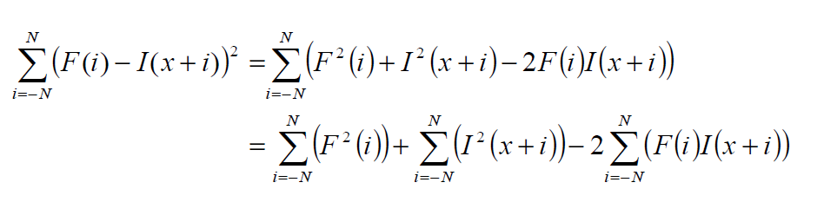

Template matching with correlation
The template can be seen as a filter.
The correlation result can be seen as a response. The higher the response, the higher the match.
However, sometimes, we might get high response in areas where the image has high intensities.
Therefore, some additional operations are applied to the correlation response: sum of squared differences, normalized cross-correlation.
template
image
correlation response
Notes:
In this case, we can think of correlation as a measure of similarity.

Slide 6
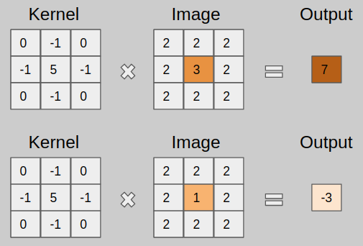
Correlation in 2D
This type of kernel increases the contrast and sharpens the image.
Image Source: https://towardsdatascience.com/types-of-convolution-kernels-simplified-f040cb307c37

Slide 7

Correlation vs. convolution
Technically, convolution is a “flipped correlation”.
In 2D, we flip the filter both horizontally and vertically.
Mathematically, the key difference between the two is that convolution is associative.
If F, G filters, then
In practice, convolution is used for image processing operations (e.g. smoothing) and when we might want to apply a series of filters (so we are interested in the associative property)…
…While correlation is used for template matching.
When the filters are symmetric, convolution is equal to correlation.
Both convolution and correlation are shift-invariant, so they are applied to each pixel in the image.

Slide 8
The “Convolution” in Convolutional Neural Networks
Many neural network libraries implement the correlation operation, even if by convention, they call it convolution.
In many CNNs, flipping or not the kernel doesn’t make a difference.

